Slide 1

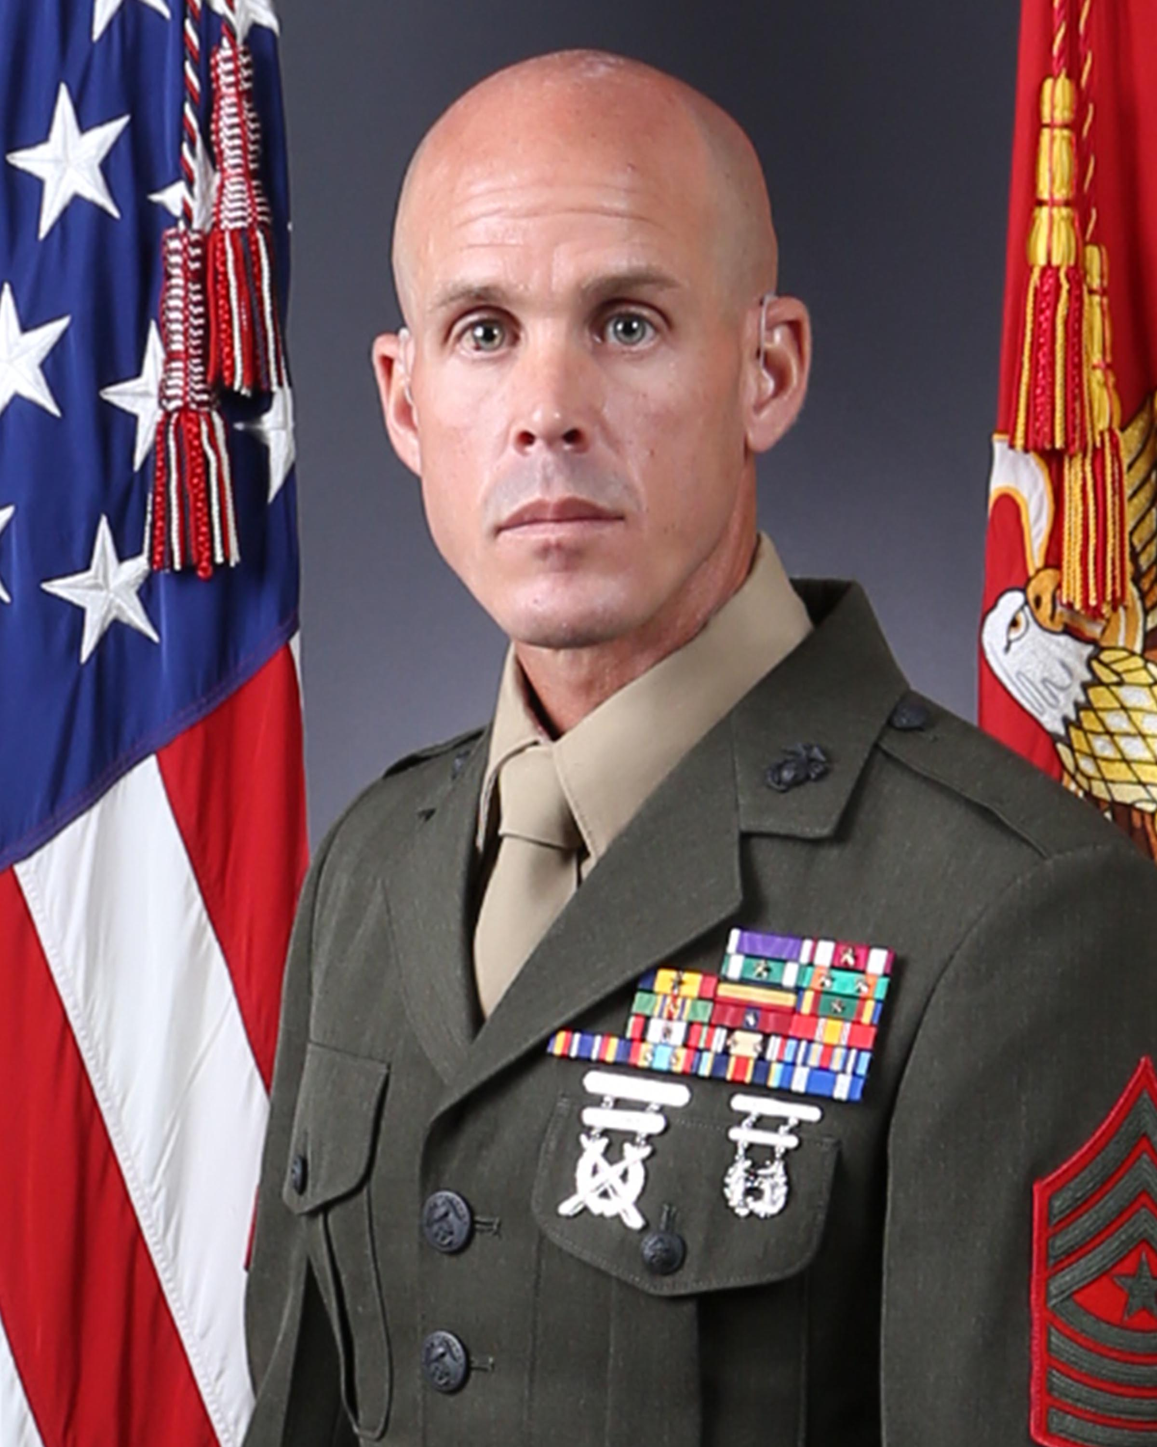
SgtMaj P. E. Fay
Sergeant Major, Combat Logistics Regiment 27

Slide 2
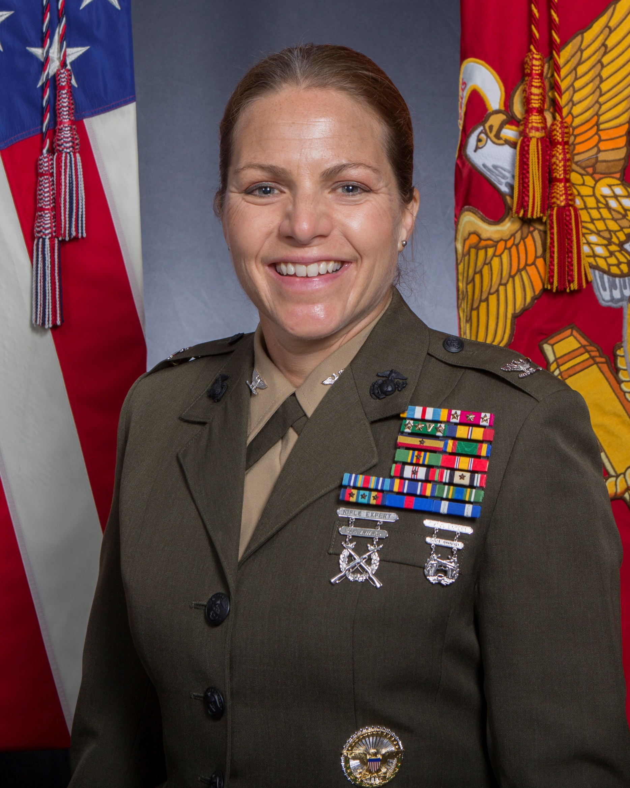
Col L. S. Edwards
Commanding Officer, Combat Logistics Regiment 27

