Slide 1
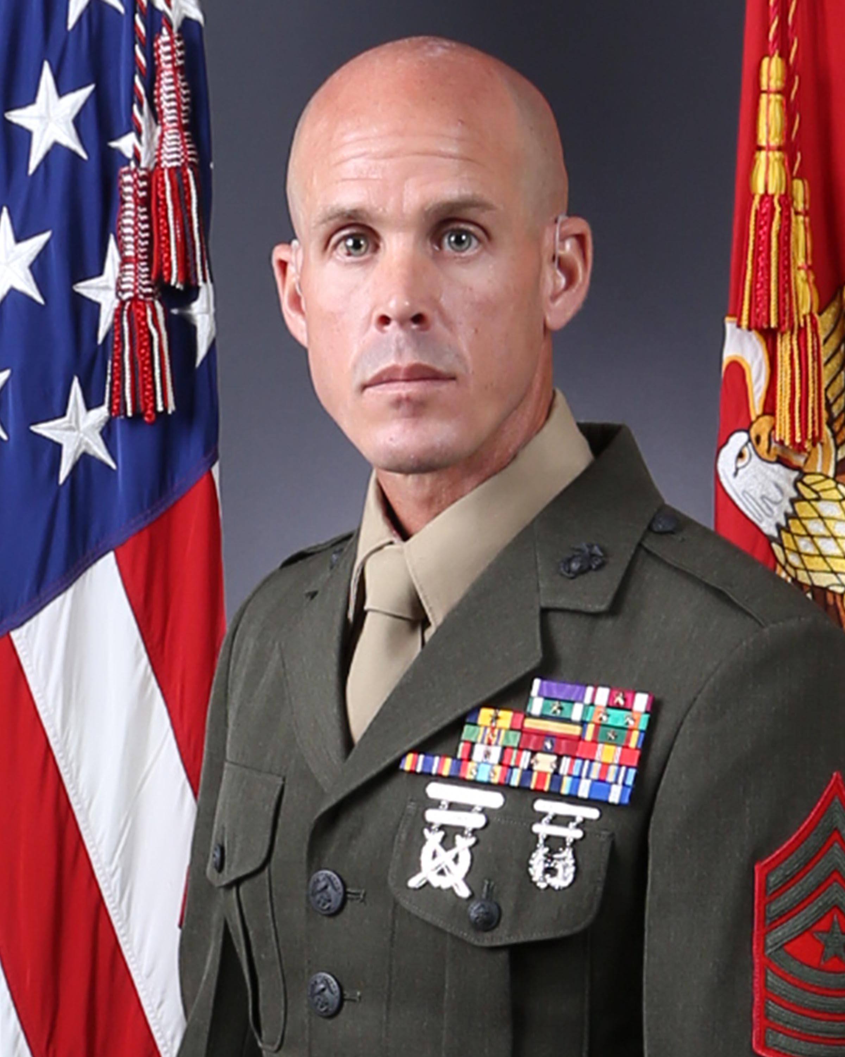
SGT MAJ P. E. FAY
SERGEANT MAJOR, CLR 27

Slide 2
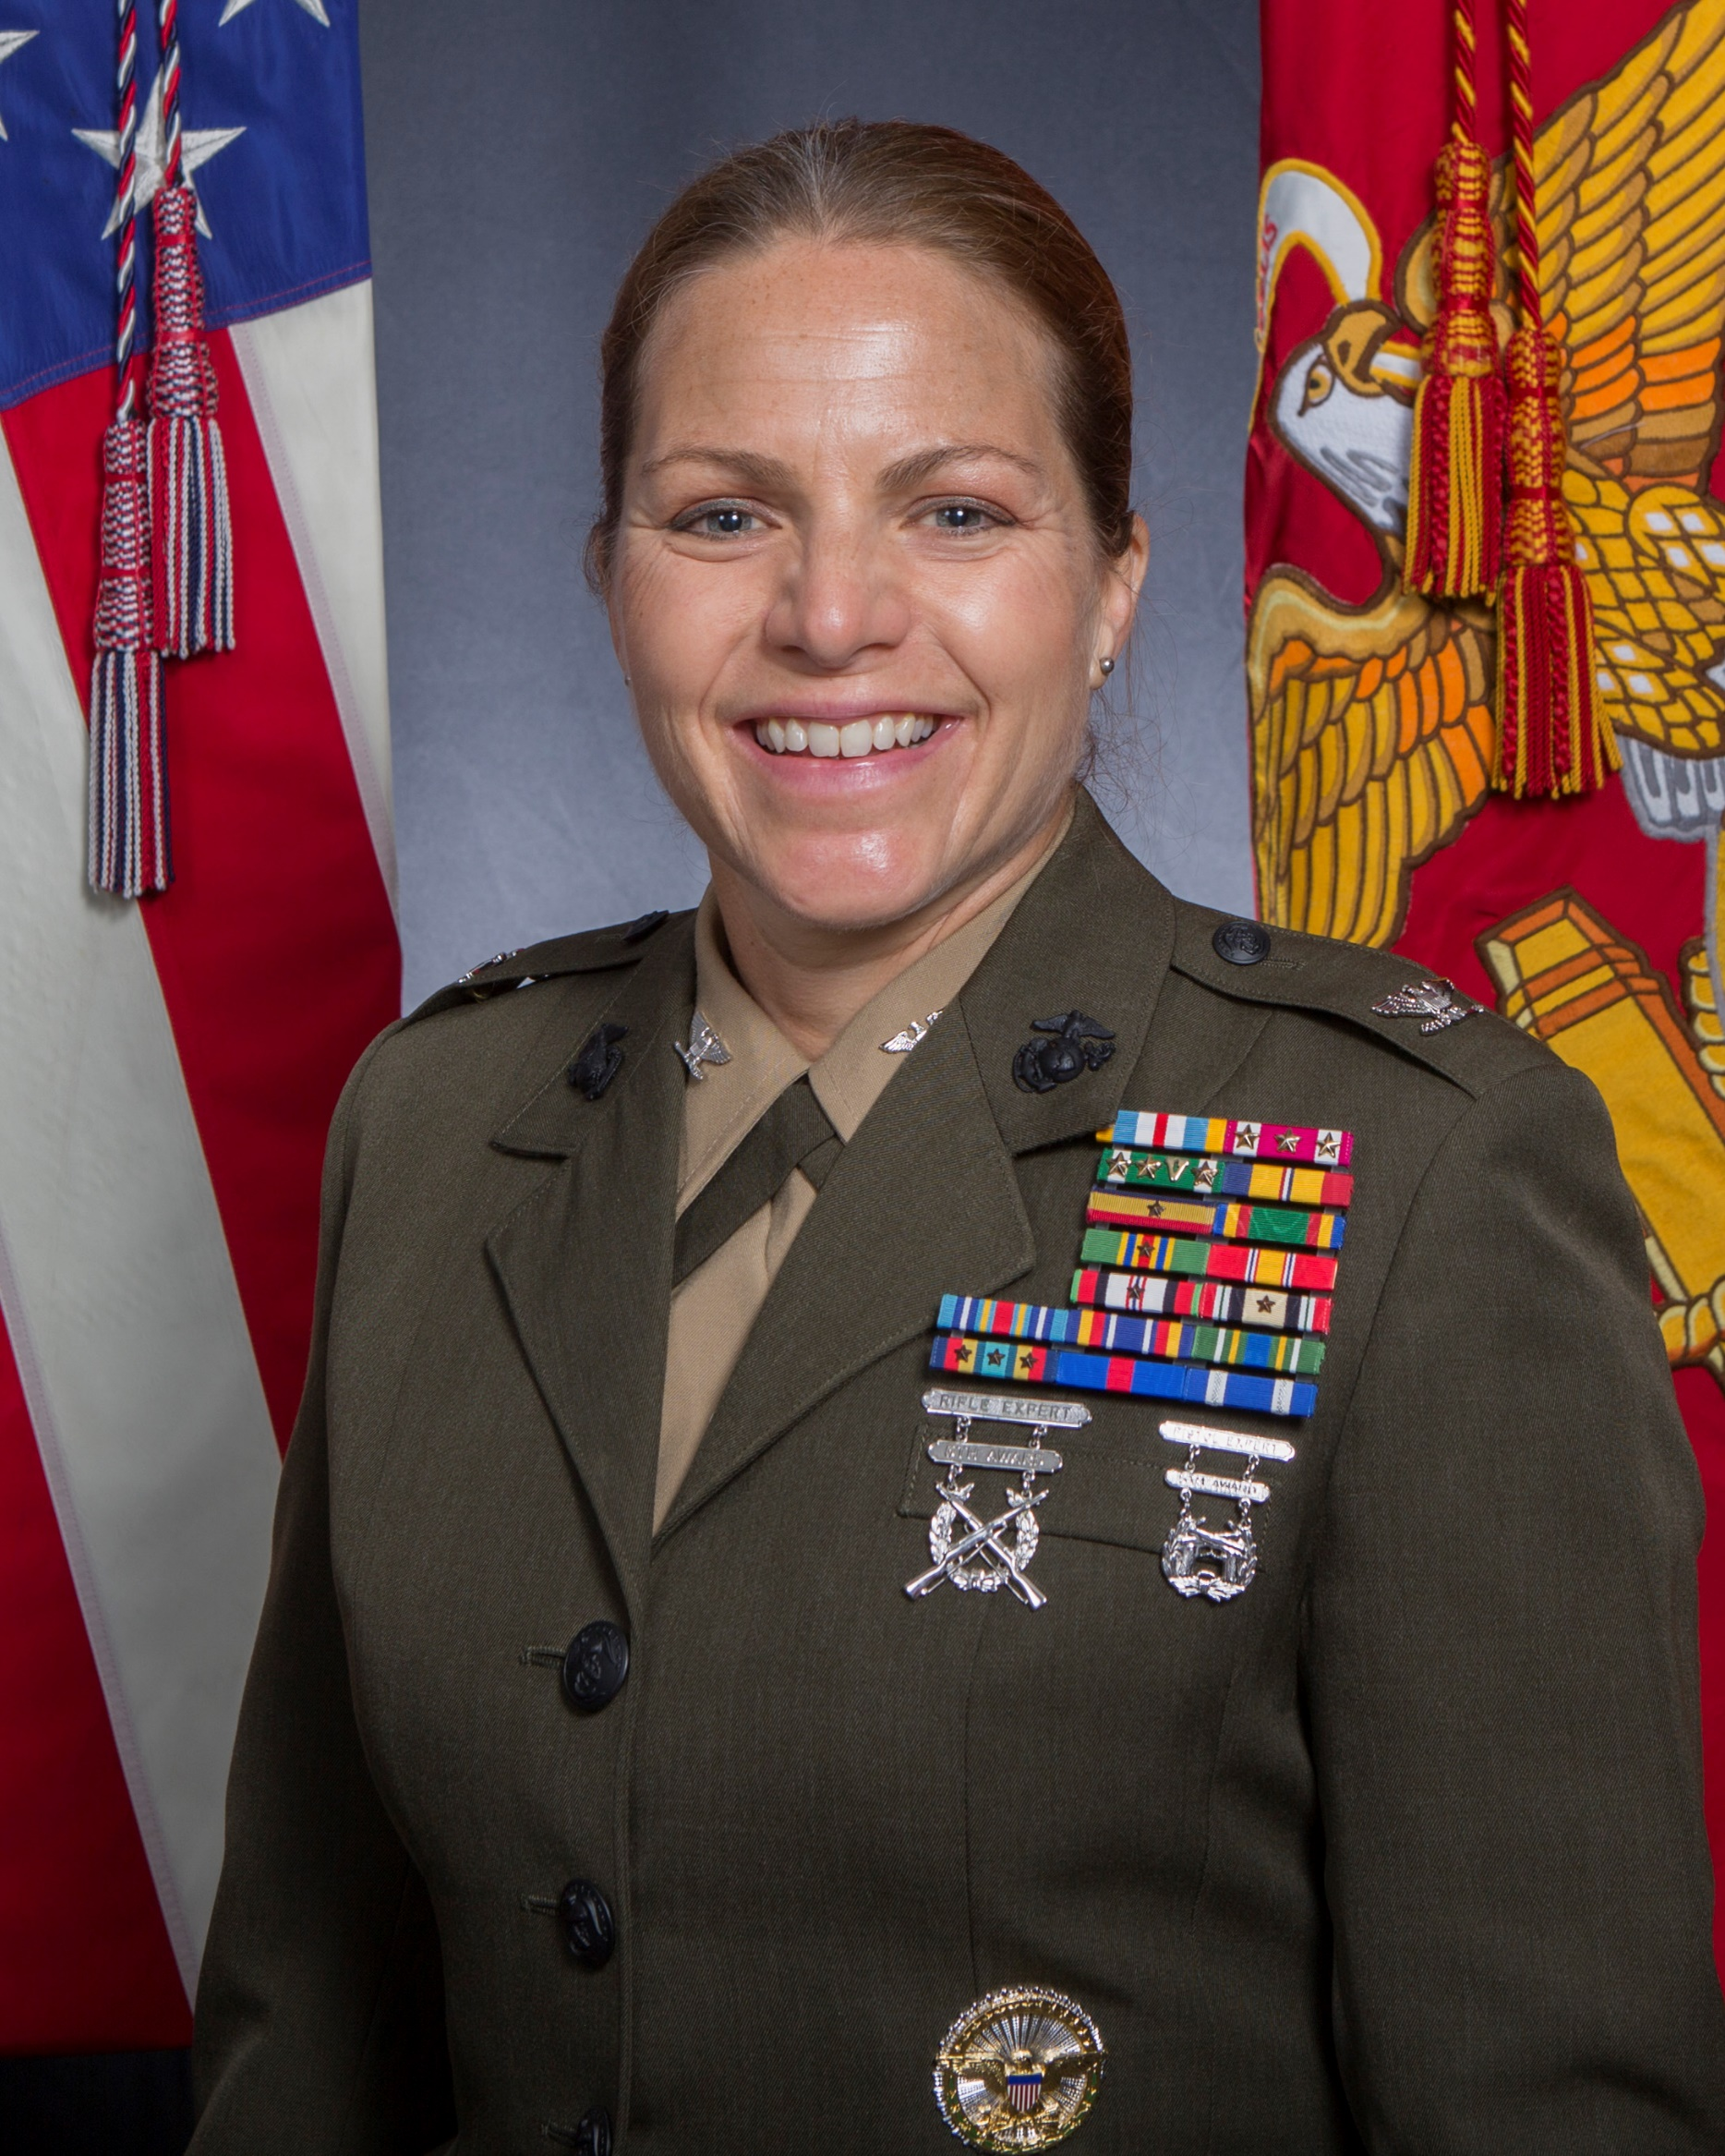
COL L. S. EDWARDS
COMMANDING OFFICER, CLR 27

